Slide 1
DS504: Natural Language Processing
Project: Machine Translation
Group # Amar Budhiraja Sudhir Sharma Anshu Kumar
Hrishik Rajesh Kanade
12040100
12041500
12040260
12040670

Slide 2
Data Preprocessing
We need to generate two copies of the translated sentence: one with the start-of-sentence token and the other with the end-of-sentence token.
Each line is split into two substrings at the position where the tab occurs.
The left substring (the English sentence) is inserted into the input_sentences[] list.
The substring to the right of the tab is the corresponding translated French sentence.
The <eos> token is prefixed to the translated sentence, and the resultant sentence is appended to the output_sentences[] list. Similarly, the <sos> token, is concatenated at the start of the translated sentence and the result is added to the output_sentences_inputs[] list.

Slide 3
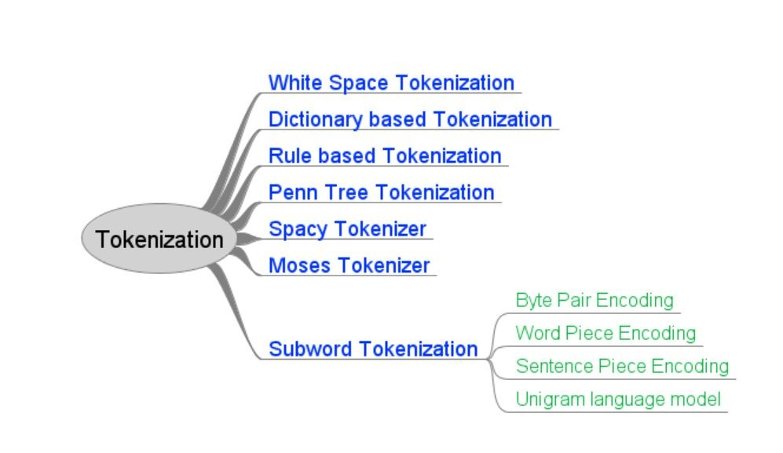
Tokenization and Padding

Slide 4
After tokenizing, padding is applied to any sentences that are either too long or too short. In the case of inputs, this padding will be equal to the length of the longest input sentence.
In addition, the word_index attribute of the Tokenizer class returns a word-to-index dictionary where words are the keys and the corresponding integers are the values.
English sentences are typically shorter and include fewer words on average than the translated French sentences, according to a comparison of the number of unique words in the input and the output.
The input has to be padded next. Because text sentences can be of different lengths, but LSTM expects input instances with the same length, padding is used for both the input and the output. Because of this, we must turn our sentences into fixed-length vectors. Padding is one method for achieving this.
A specific sentence length is established in padding. In our example, the input and output sentences will be padded by the length of the longest sentence from the inputs and outputs, respectively. The input's longest sentence is six words long. Zeros will be added to the empty indexes for sentences with fewer than six words.

Slide 5
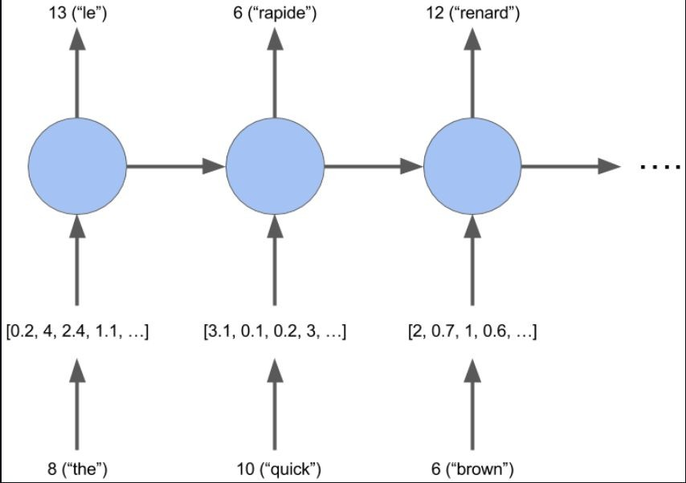
Word Embedding
Because we are employing deep learning models, we must convert our words into their appropriate numeric vector representations.
Our words, however, have already been converted into numbers. So, what is the difference between word embeddings and integer representation?

Slide 6
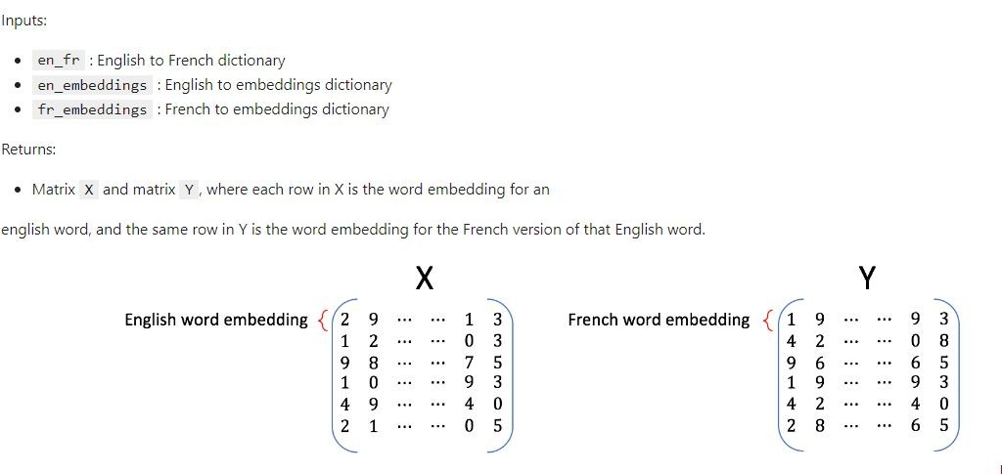
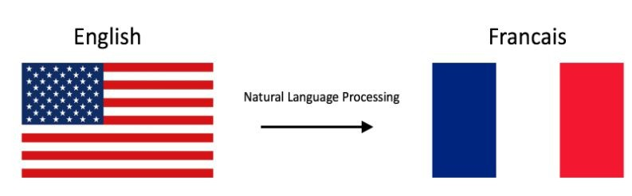
Translating English dictionary to French by using embeddings
Given dictionaries of English and French word embeddings
you will create a transformation matrix R
Given an English word embedding, e, we can multiply
eR to get a new word embedding f
Both e and f are row vectors.
We can then compute the nearest neighbors to f in
the french embeddings and recommend the word that
is most similar to the transformed word embedding.

Slide 7
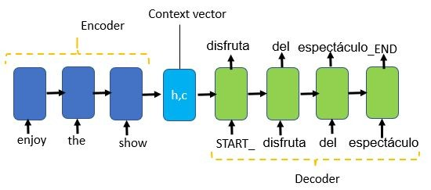
Making The Model
The most common architecture used to build machine translation models is Encoder-Decoder
architecture and we are using the same for our project.
We used two major components — an encoder and a decoder for our model.

Slide 8
Encoder
Both encoder and the decoder are LSTM model
Encoder reads the input sequence and summarizes the information in something called the internal state vectors or context vector (in case of LSTM these are called the hidden state and cell state vectors). We discarded the outputs of the encoder and only preserve the internal states. This context vectors aims to encapsulates the information for all input elements in order to help the decoder make accurate predictions.
Decoder
The deoder is an LSTM whose initial states are initialized to the final states of the final states of Encoder LSTM, i.e the context vector of the encoder’s final cell is input to the first cell of the decoder starts generating the outputs are also taken into consideration for future outputs.

Slide 9
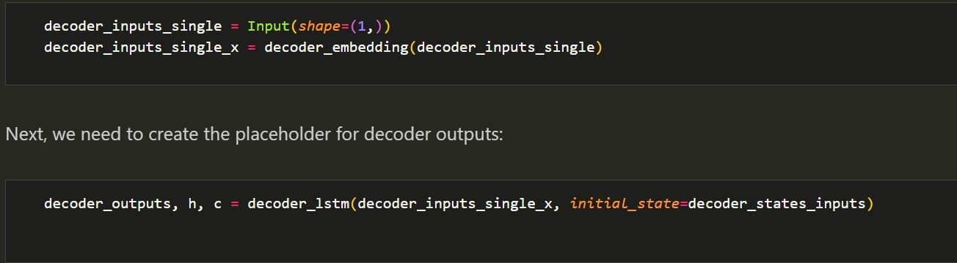
Modifying the Model for Predictions
Since at each step we need the decoder hidden and cell states, we will modify our model to accept the hidden and cell states as shown below.
At each step, there will be only single word in the decoder input and we need to modify the decoder embedding layer as follows:

Slide 10
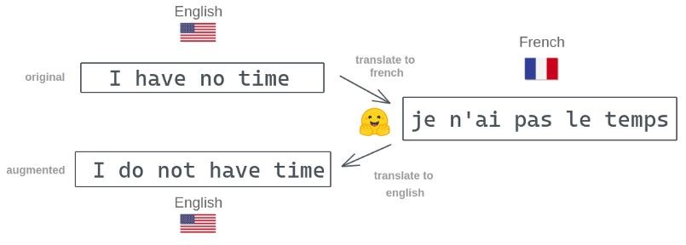
Making Predictions
As we know, Words were transformed into integers throughout the tokenization processes. The decoder will also produce integer outputs.
On the other hand, we need a string of French words as our output. We must do this by changing the integers back to words. For both inputs and outputs, we will create new dictionaries with words as the corresponding values and integers as the keys.
3. Finally We have created
translate_sentence
function that gets english sentence as a input
and returns french sentence.

Slide 11
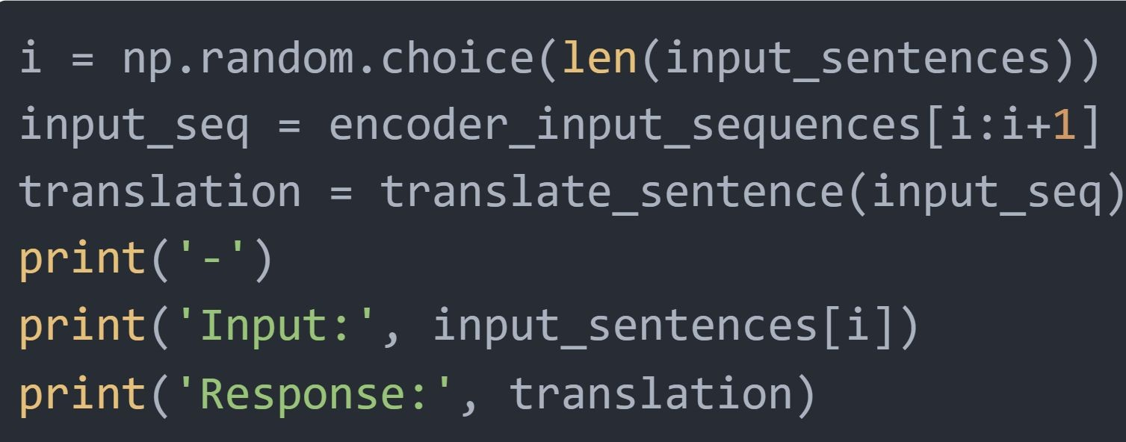
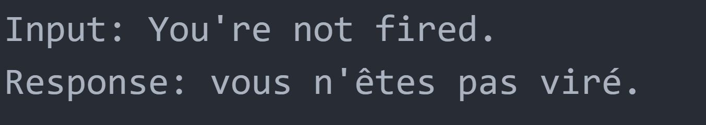
Testing the model
To put the code to the test, we will select a sentence at random from the input sentences list, retrieve the associated padding sequence for the sentence, and feed it
to the method. The translated sentence will be returned by the
translate_sentence
procedure, as seen below.
Input
Output

